Slide 1




Cost Recovery
Joint UNDP, UNFPA, UNICEF and UN Women Executive Boards briefing
26 April 2017

Slide 2
Outline
Recap on EB bureau feedback on cost recovery
Role of core
Cost recovery models
  a. ‘LEGO’ (building block) approach for cost recovery modeling
High level overview
Cost recovery rates by agency based on ‘LEGO’ approach
Harmonization
EBs guidance and next steps
6. Q & A
Supporting information in Annexes

Slide 3
Recap – 28 March EBs feedback on the “Note for the proposed way forward on cost recovery”
Approach
A consideration of the need for an update of the Executive Board-document on the Road map to an integrated budget (DP-FPA/2010/1-E/ICEF/2010/AB/L.10 of July 19, 2010); a revision or confirmation of the list of critical cross cutting functions (that can be deducted from the cost recovery amounts); and a revision of the exceptions to the 8% ‘normal’ rate.
An assessment of the current cross-subsidy amounts and future trends with different funding scenarios (core / non-core trends) and its consequences on the cost recovery set-up and rates.
Development of different options for cost recovery, for example have the General Management Support (GMS) rate depend on the volume of the donation. An assessment whether government cost sharing arrangements (having low rates) cover the expenses they generate.
An assessment of the adequacy of cost recovery rates and proposed future options (or updates) for these rates.
Prepare an (updated) proposal for a cost recovery system to be presented to the board for decision, valid for the period 2018-2021, either identical across agencies or adjusted to the different agencies.
Process
The joint briefings with the Executive boards planned for late May 2017 should include a presentation of and discussion on the proposed cost recovery system
The planned timeline should include proposed timing for a decision on the approach to the cost recovery system for the period 2018 – 2021.

Slide 4
Role of Regular (core) Resources
The QCPR emphasizes two critical concepts:
Core (regular) resources form the bedrock of UN operational activities for development, owing to their untied nature.
Regular resources should not subsidize other resources (need for full proportional cost recovery)
These concepts guide the current methodology and the options presented.
There is a difference in the role of core and non-core. The role of core includes support to Member States in the establishment and implementation of UN norms and standards, as opposed to a project implementation agency.
There is a need to ensure that a minimum level of specific essential functions be funded from the core. These functions would thus not be subject to cost recovery, and would include:
functions mandated to benefit the broader UN development system; and
functions related to establishing and implementing UN norms and standards across programmatic and institutional areas of work of each agency
Subsequently, core resources will be used for funding of programmatic activities and the proportional share of the institutional budget, noting its synergistic and complementary nature to the programme activities.

Slide 5
A modular approach to cost recovery models – (the ‘LEGO’ approach)
The cost recovery model is designed to recover the designated costs of the Institutional Budget - thus the starting point is the total Institutional Budget
From this starting point, “blocks” are presented to provide a spectrum of what can be considered as a minimum level of specific, essential functions to be funded from core resources. These “blocks” would then be excluded from cost recovery
The modular “Lego” approach for cost recovery allows for consideration of various options, in line with request of the EBs

Slide 6
The ‘LEGO’ approach for activities funded from core: three blocks
Block | Description
Executive leadership, Country Office leadership, Independent Assurance | Executive Office, Ethics and Ombudsman Independent corporate oversight and assurance Internal and external audit and investigation Evaluation Posts of Representative and Deputy Representative (or national equivalent) Support to UN Development Coordination
Directing advocacy, resource stewardship and technical leadership | Leadership of management and development effectiveness functions at HQ and RO levels: Fiduciary, IT, Human Resources, Partnerships and Security management functions Technical leadership, programmatic policy and support for norm setting functions
Integrating professional standards, norms and quality assurance | Remaining development effectiveness functions: Integration of professional standards and quality assurance Programme-policy advisory functions
1 is the minimum. Moving from 1 to 3, the amount funded from core increases

Slide 7
Why the “LEGO” approach?
Opportunity for EB members to provide direction on what they see as a critical role of core resources
LEGO approach - blocks are independent of each other so the final model can be adjusted based on the EB members’ priorities, noting the logical connections among them
Thus the indicative rates presented later on, reflect cumulative combinations of the building blocks
They are for illustration / guidance and are subject to change depending on the final combination chosen

Slide 8
Financial implication of the cost recovery model [core + non core]
Scenario with increased contributions
Scenario with decreased contributions
Programme
LEGENDS
Programme
Programme activities are funded from all sources of funds.
Programme
Increase
Change in contributions impacts the resources allocation to Programmes, as well as the level of institutional budget subject to cost recovery - i.e. the ‘cost recovery charge’ related to managing programmes
Decrease
Programme
IB subject to cost recovery is funded from all sources of funds.
Programme
LEGO BLOCKS activities are fully funded from core and do not grow or shrink despite changes in the contribution levels.
IB subject to Cost Recovery
Increase
IB subject to cost recovery
The chosen blocks would remain stable and hence not grow or shrink, irrespective of volume of contributions. Agencies will report on the actual performance annually as part of the organization’s Annual report (financial annex).
Decrease
IB subject to Cost recovery
[LEGO BLOCKS]
No change
[LEGO BLOCKS]
No change
[LEGO BLOCKS]

Slide 9
Overview of costs covered by core vs. cost recovery
 | Starting point | Current Model (per decision 2013/9) | Executive leadership, C.O. leadership, Independent Assurance | Previous plus Directing advocacy, resource stewardship and technical leadership | Previous plus Integrating UN norms & standards; and quality assurance
 |  |  | Green | Green + Yellow | Green + Yellow + Blue
Core covers | Programmes | Programmes Coordination activities; Development Effectiveness activities; Critical cross-cutting management functions | Programmes Coordination activities; Executive & CO leadership, Independent assurance; | Programmes Coordination activities; Executive & CO leadership, Independent assurance; Directing advocacy, resource stewardship and technical leadership | Programmes Coordination activities; Executive & CO leadership, Independent assurance; Directing advocacy and resource stewardship; Professional standards, Quality assurance, normative work & thought leadership
Institutional Budget subject to Cost Recovery covers | Full Institutional Budget | Management activities except: critical cross cutting management functions | Management and development effectiveness activities, except Executive leadership; Country Office leadership, Independent Assurance | Management and development effectiveness activities, except: Executive & CO leadership; Independent Assurance; Directing advocacy, resource stewardship and technical leadership | Management activities, except: Executive & CO leadership, Independent Assurance; Directing advocacy & resource stewardship

Slide 10
Cost recovery rates by agency based on LEGO approach
Agency | Starting point | Current Model (per decision 2013/9) | Protected: Executive leadership, Country office leadership, Independent assurance | Protected: Previous plus Directing advocacy, resource stewardship and technical leadership | Protected: Previous plus integrating UN norms and professional standards, quality assurance
 |  |  | Green | Green + Yellow | Green + Yellow + Blue
UNFPA | 19.3% | 9.7% | 10.1% | 8.2% | 7.3%
UNDP | 13.9% | 7.3% | 9.5% | 8.6% | 7.0%
UNICEF | 13.6% | 7.8% | 10.2% | 9.6% | 7.0%
UN Women | 29.6% | 8.5% | 16.5% | 12.6% | 8.4%
Rates shown cumulatively, for illustration. Final rates will depend on the combination chosen.
The lower the cost recovery rate (due to higher level of protected functions), the greater the draw on core resources.

Slide 11
Harmonization - implications
  Due to different mandates, business models and economies of scale, the calculation of a single notional cost recovery rate for the four agencies will be very challenging.
  Where the harmonized standard rate is lower than the required cost recovery rate, the shortfall would be funded from regular (core) resources (or, in the case of UN WOMEN, also from assessed contributions).
  Nevertheless, agencies agree that it is much more beneficial to continue to have a harmonized rate for comparable activities. Key benefits are presented in the next slide

Slide 12
Harmonization – implications (cont.)
The case for harmonization
A harmonized rate is an integral dimension to UN coherence, particularly at the country level
Provides the right incentives for Delivering as One and Joint programming
This becomes increasingly essential in the context of the the call for agencies to work even closer together to help achieve SDGs
Eliminates or reduces the competition among the UN agencies
Simplifies negotiation and reduces the transaction costs

Slide 13
Timing of the EBs’ decision on cost recovery vs. the Organizations’ Integrated Budgets 2018-2021 (*)
  Two options exist for EB decision on cost recovery (if made in 2017):
    Annual session 2017 (June); or
    Second regular session 2017 (September)
  Challenge to integrate cost recovery decision into the Integrated Budget:
    Agencies would need time to incorporate the implications of any change in the decision on cost recovery in their Integrated Budget documents
    Budget documents must be ready latest by mid-June, in order to present institutional component of Integrated Budget to ACABQ so that ACABQ can give guidance to the Executive Board in time for the September formal discussion and decision on the Integrated Budget
(*) 2018-2019 Integrated budget for UN Women

Slide 14
Timing of the EBs’ decision on cost recovery vs. the Organizations’ Integrated Budgets 2018-2021 (*)
  The preparation of the 2018-2021 integrated budget for September 2017 would be done based on the currently approved cost recovery methodology & rates.
  Adjustment of the Integrated Budget to reflect implementation of a new cost recovery decision could be done using one of the following options:
    Present ad-hoc budget revision in September 2018 for the 2019-2021 period, reflecting implementation of cost recovery decision effective 1.1.2019
    Present ad-hoc budget revision in September 2019 for the 2020-2021 period, reflecting implementation of cost recovery decision effective 1.1.2020
(*) 2018-2019 for UN Women

Slide 15
Executive Boards’ guidance sought
            Executive Boards to provide guidance on:
              The role of core, including which LEGO blocks are to be considered to be funded from core
              Continued use of harmonized rates, based on the presented options, noting the implications on core resources
            Against the backdrop of GA resolution 71/243 on the QCPR and guidance of the Executive Boards:
              Proposed timeline for cost recovery decision, June or September 2017
              Preparation of Integrated Budgets, 2018-2021 / 2018-2019

Slide 16
Next steps
Based on the guidance provided today:
            Discuss impact of the differentiated rates on the cost recovery due to different governing mechanisms of multi-lateral and non-governmental donors; develop options on differentiated rates for EXB consideration
            Discuss impact of the volumes on cost recovery (i.e. premium rates for lower volume, discounted rates for higher volume); develop options on volume for EXB consideration
Agencies will also:
            Continue to monitor and report on actual cost recovery on an annual basis
            Continue to strongly advocate for inclusion of eligible direct costs in programmes/projects

Slide 17
Q & A

Slide 18
Supporting information
Annex I – Recap of the current cost recovery model
Annex II – Summary of historical cost recovery information based on 2014-2016 financial data
Annex III - VI - Agency Specific Detail

Slide 19
Annex I
Recap of the current cost recovery model

Slide 20
CURRENT Executive Board approved model cost recovery – step by step
Illustrative Example:
Proportionate percentage share of RR and OR in the planned use of resources
Other resources: $60
Regular resources: $40
Inst. Budget: $12.6
Development Effectiveness: ($2)
Non-comparable Special Purpose: ($1)
UN Dev. Coordination: ($1)
Critical cross-cutting: ($1)
IB Subject to cost
recovery: $7.6
Step 1: Calculate the sum of management and comparable Special Purpose costs and remove costs related to critical, cross-cutting functions
Step 2: Take the amount calculated in step (1) and split it proportionally according to the levels of total planned core and non-core expenditures
IB proportion OR (7.6*60%) = $4.56
IB proportion RR (7.6*40%)= $3.04
Step 3: Take the amount calculated in step (2) to be recovered from non-core resources and calculate it as a percent of total planned non-core development expenditures
IB proportion OR: $4.56 / ($60-$4.56) = 8.2%
IB proportion RR: $3.04 / ($40-$3.04) = 8.2%
Step 4: The amount in step (3) equals the notional cost-recovery rate on non-core resources
Result of step 4 = 8.2% established cost recovery rate

Slide 21
Annex II
Summary of historical cost recovery information based on 2014-2016 financial data
Cost recovery Waivers
Notional cost recovery rates per the Current model
Effective average cost recovery rates.

Slide 22
Number of Waivers – 2014, 2015 and 2016
Number of waivers | 2014 | 2015 | 2016
UNDP | 24 | 9 | 12
UNFPA | 3 | 6 | 8
UNICEF | 1 | 9 | 0
UN Women | 1 | 1 | 6
            Per EB decision, “on an exceptional basis (….) the Administrator (…) and the Executive Director (…) may consider granting a waiver of the cost-recovery rates on a case-by-case basis, (…) and that the Executive Board will be informed of these waivers in the annual financial reports”
            Total financial impact of the cost recovery waivers in response to partner requests is immaterial (but should continue to be given very exceptionally)
            The waivers granted are reported in the respective agency annual reports

Slide 23
Effective cost recovery rates 2014 -2016 by agency
The effective rate represents the rate that was realized based on the actual cost recovery vs. the actual OR spending*. These rates were also reported in the independent external consultants’ report.
Agency | 2014 | 2015 | 2016
UNDP | 6.1% | 6.3% | 6.4%
UNFPA | 7.07% | 7.10% | 7.27%
UNICEF | 6.3% | 6.5% | 6.6%
UN Women | 7.12% | 7.00% | 7.14%
*For UN Women, based on collected revenue
** UNFPA revised the 2014 and 2015 effective rates to only reflect the other resources that are subject of cost recovery credit to the Institutional Budget
Details for each Agency are presented in the Annexes at the end of this presentation

Slide 24
Executive Board approved model – calculation of notional rate using 2014, 2015 and 2016 actuals
The rates below result from applying the Executive Board approved methodology to 2014 , 2015 and 2016 actuals:
Agency | 2014 | 2015 | 2016
UNDP | 7.9% | 7.0% | 7.0%
UNFPA | 7.8% | 8.1% | 8.3%
UNICEF | 6.2% | 6.0% | 5.8%
UN Women | 8.3% | 8.1% | 6.6%
Details for each Agency are presented in the following Annexes

Slide 25
Annex III
UNFPA specific details

Slide 26
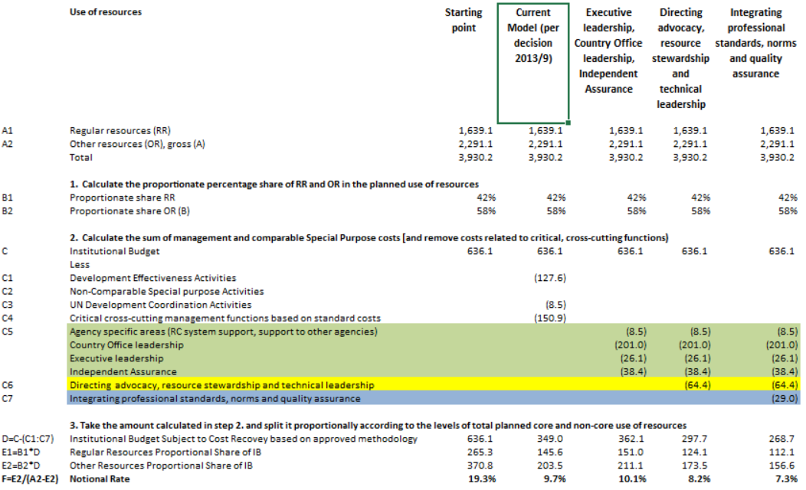
UNFPA: Comparison current vs. potential adjusted methodology based on 2014-2017 MTR (annex I) (in US$ Million)

Slide 27
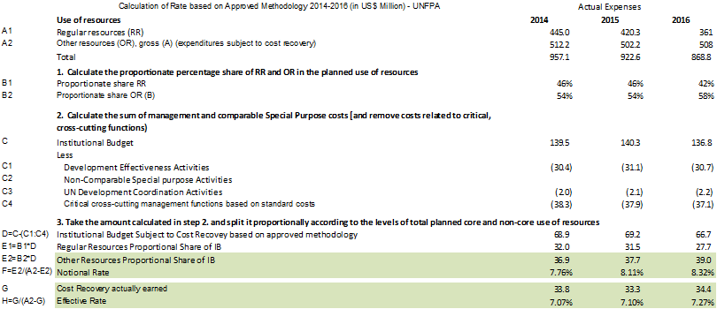
UNFPA Calculation of rate in line with approved formula in documents DP-FPA/2013/1–E/ICEF/2013/8

Slide 28
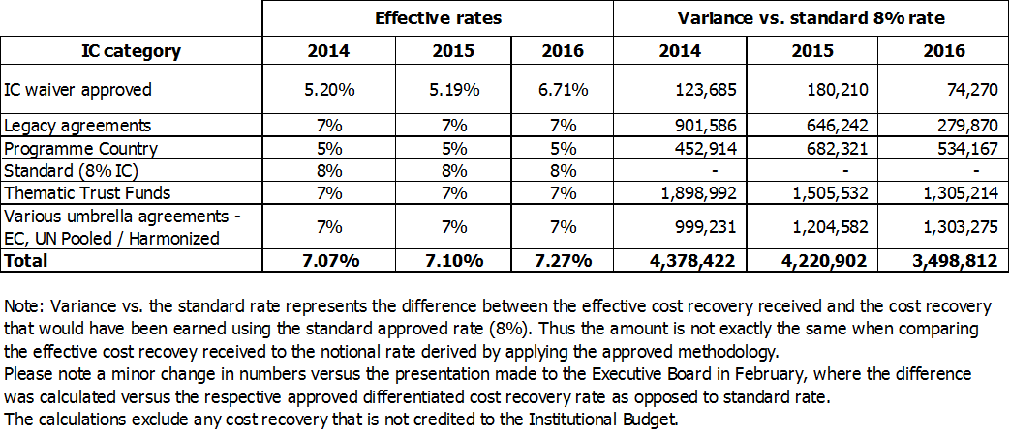
UNFPA – impact of differentiated rates, legacy and waivers vs. the standard rate

Slide 29
Annex IV
UNICEF specific details

Slide 30
UNICEF: Comparison current vs. potential adjusted methodology based on 2014-2017 IB) (in US$ Million)

Slide 31
UNICEF Calculation of rate in line with approved formula in documents DP-FPA/2013/1–E/ICEF/2013/8

Slide 32
UNICEF Impact of differentiated rates vs standard (8%) in 2014-2016

Slide 33
Annex V
UN Women specific details

Slide 34
UN WOMEN
UN Women has a formal normative mandate as established by its founding resolution 64/289. Normative leadership positions are funded from Assessed contributions and thus not included in the Institutional Budget unlike the other sister entities. These leadership positions include Executive Director (USG\ED), one of the two Deputy Executive Directors (ASG), Chief of Staff (D2). This alters the basis for comparison (where leadership is paid for by IB by other agencies), leading to a much higher rate for UN Women than other agencies

Slide 35
UN Women: Comparison current vs. potential adjusted methodology (based on 2018-2019 IB) (in US$ Million)

Slide 36
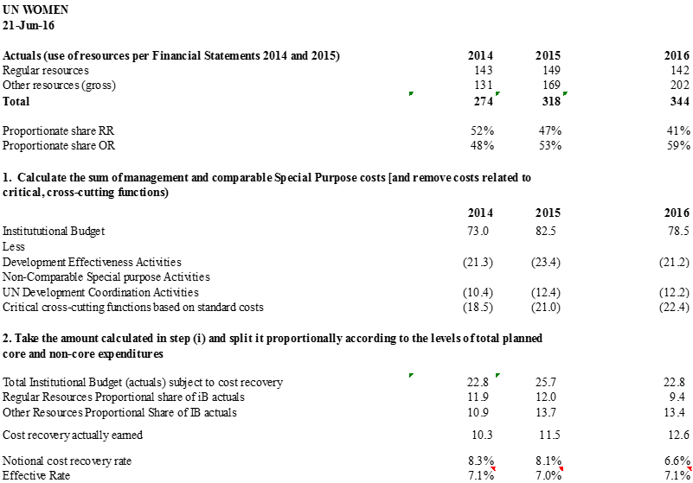
UN Women Calculation of rate in line with approved formula in documents DP-FPA/2013/1–E/ICEF/2013/8

Slide 37
UN Women Effective indirect cost recovery rates 2014, 2015 & 2016
Year | Collected Revenue (A) | Support cost Recorded (B) | Effective Rate (B/A)
2014 | 146,110,705.37 | 10,367,460.42 | 7.10%
2015 | 165,030,949.79 | 11,529,076.89 | 6.99%
2016 | 176,633,568.90 | 12,603,540.34 | 7.14%

Slide 38
Annex VI
UNDP specific details

Slide 40
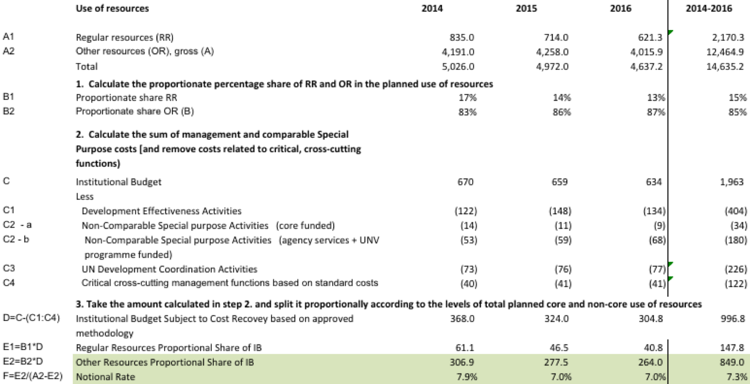
UNDP Calculation of rate in line with approved formula in documents
DP-FPA/2013/1–E/ICEF/2013/8
(*) Based on data reported in UNDP ARFS for 2014 and 2015 in annexes 1&2, net of GLOC and in-kind contributions

Slide 41
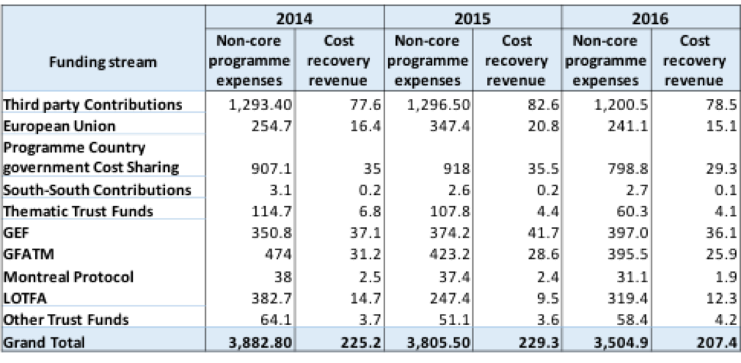
UNDP - Effective average cost recovery rate calculation
with amounts by funding stream in US$ million dollars
Effective average cost recovery rate: 2014 2015 2016
6.1% 6.3% 6.4%
The effective average cost recovery rate is calculated as follows:
Total Cost recovery revenue
______________________
(Total non-core programme expenses less Total Cost recovery revenue)
Planning assumption for implementing cost-recovery rate of 8% was that 75 per cent of 3rd party agreements would be in compliance with the cost recovery policy by the end of 2016. However, UNDP exceeded that initially envisaged level by achieving 89 per cent rate of the compliance by the end of 2016.
Notes:
1.All amounts from Atlas GL in line with UNDP audited Financial Statements for 2014 and 2015 and unaudited Financial Statements for 2016.
2.Note that in calculation of the effective average cost recovery rate, the denominator is adjusted for $34.3m for 2014, $38.5m for 2015 and for $45.4m to take into account GEF/Montreal Protocol related accounting.
3.Programme country governments also contribute to offset local office costs through cash as well as in-kind contributions.

Slide 42
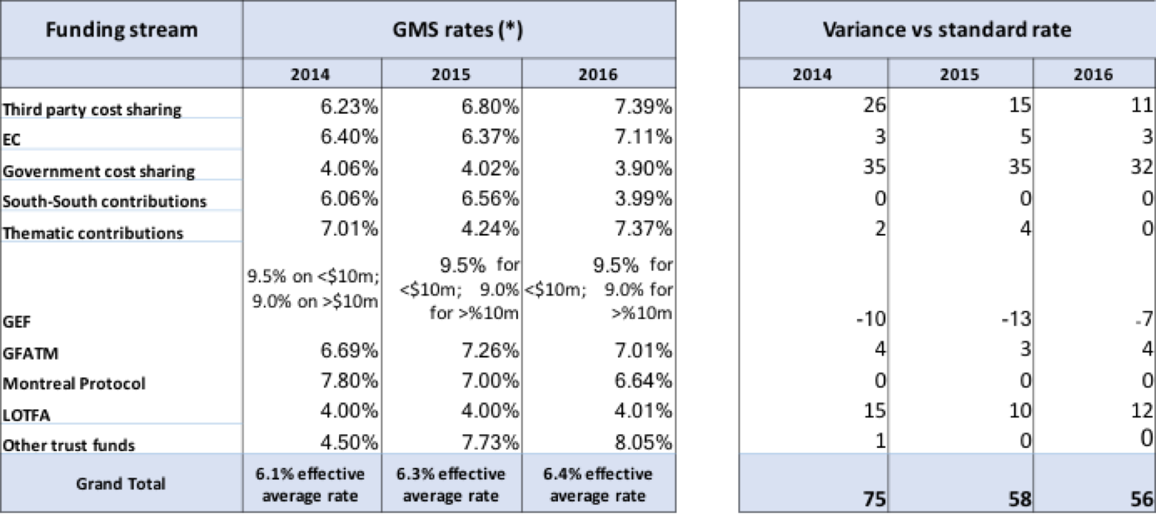
UNDP - impact of differentiated rates vs. the standard (8%) cost recovery rate in 2014-2016
in US$ millions
GMS cost recovery rates are in line with rates reported in UNDP’s annual report of the administrator for 2014 and 2015 (2016 rates are from draft report).

